Slide 1
Introduction to Wireless Network
Chapter 2

Slide 2
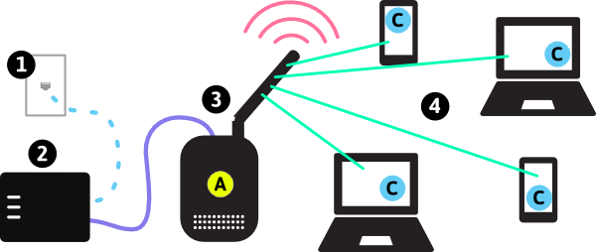
Contents
Introduction
General Computer Communication Network Architecture
  Wired Communication Network Infrastructure
  Wireless Communication Network Infrastructure
Different Types of Wireless Communication Systems
  Classification of Wireless Communication Systems
    Based on Coverage
    Based on Topology
    Based on Mobility
  Wireless Personal Area Networks
  Wireless Local Area Networks
  Wireless Wide Area Networks
Summary

Slide 3
Introduction
A wireless communication network is
  A computer network that uses a wireless connection between network nodes.
  A method to connect telecommunications networks, and business installations or to connect between various equipment locations, to avoid the costly process of introducing cables.
Examples of wireless communication networks include
  Cellular networks
  Wireless local area networks (WLANs)
  Wireless ad-hoc networks
  Wireless sensor networks
  Vehicular communication networks
  Satellite communication networks.

Slide 4
Wired Communication Network Infrastructure
User equipment in wired networks is referred to as fixed communication terminals due to limited mobility.
In the early days, user equipment such as land-line telephones and desktop computers are directly connected to a network switch or a network router through physical network cables.
In modern data centers and cloud computing centers, the servers are also hard wired to switches or routers. The core network consists of many switches and routers that are interconnected with physical medium, such as copper wire, Ethernet cable, fiber optics, etc.

Slide 5


Elements of a Wired Network
wired network
infrastructure

Slide 6
Wireless Communication Network Infrastructure
Most wireless communication systems only deploy wireless components at the edge of the communication infrastructure
The core network in a general wireless communication infrastructure is a wired network.
The wireless access is provided with extra components and resources to the core network infrastructure.
  Wireless transceivers: base stations, access point (AP), mobile stations (MSs), etc.
  Management entities: mobility management, power management, radio resource management, security management, etc.
  Spectrum: radio frequency bands for data transmission and possible air interface.
  Deployment: spectrum reuse in communications, wireless network design, etc.

Slide 7






















Elements of a Wireless Network
Wireless Hosts
Laptop, smartphone, IoT
May be stationary (non-mobile) or mobile
  wireless does not always mean mobility!
Wired Network
Infrastructure

Slide 8

Elements of a Wireless Network
base station
Typically connected to wired network
Relay - responsible for sending packets between wired network and wireless host(s) in its “area”
  e.g., cell towers, 802.11 access points
Wired Network
Infrastructure

Slide 9
Elements of a Wireless Network
Wireless Link
Typically used to connect mobile(s) to base station, also used as backbone link
Multiple access protocol coordinates link access
Various transmission rates and distances, frequency bands
Wired Network
Infrastructure

Slide 10
Elements of Wireless Networks
Ad Hoc Mode
No base stations
Nodes can only transmit to other nodes within link coverage
Nodes organize themselves into a network: route among themselves

Slide 11
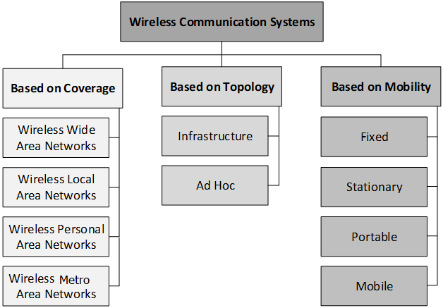
Classification of Wireless Communication Systems
Wireless communication systems can be classified in several ways, based on coverage, topology, or mobility,

Slide 12
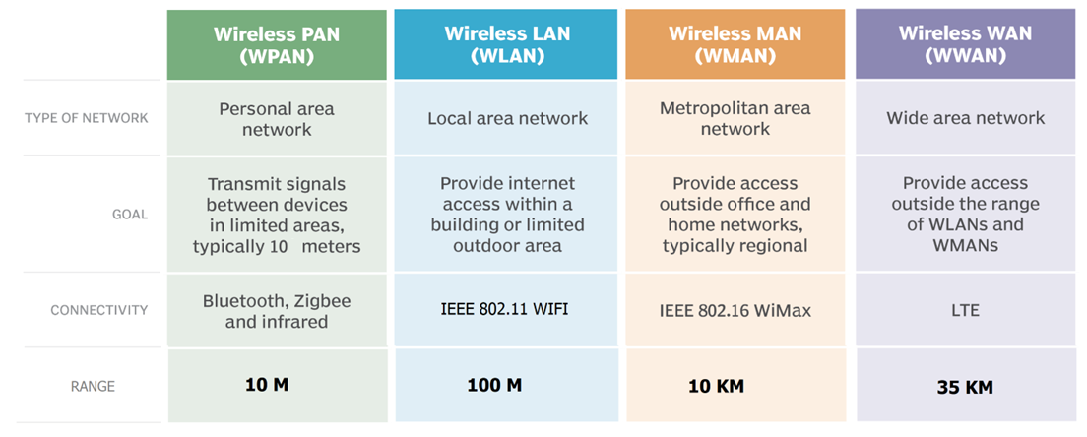
Classification Based on Coverage

Slide 13
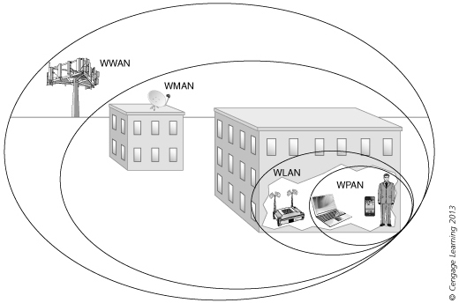

Slide 14
Wireless Personal Area Networks
A WPAN can be used for communications among the personal devices themselves.
A WPAN usually has an ad-hoc topology. Master–slave mode and mesh mode are the two types of ad-hoc networks that can be applied for WPANs.
  A master–slave ad-hoc network consists of a master node and multiple slave nodes. The master node defines a cell or piconet. The slave nodes within the piconet connect to the master device.
  Some WPANs apply mesh mode, where nodes are interconnected with wireless links without forming a specific cell or piconet

Slide 15
Master and Slave Ad-Hoc Mode

Slide 16
Wireless Local Area Networks
WLANs are infrastructure based wireless communication systems. They are normally built on top of a wired local area network (LAN).
One of the typical WLAN settings is a home Wi-Fi, which forms one basic service set (BSS) that includes one AP and multiple user devices.
The AP may have extra Ethernet ports to support wired access from servers, desktops, and other devices.
A WLAN may have extended service set (ESS) that supports multiple BSSs, similar to a traditional Ethernet based LAN.
All APs are interconnected, in most cases through wired connection.
A user may be within the radio coverage of multiple APs, each user can connect to one BSS only at a time.

Slide 17
Architecture of WLAN

Slide 18
Wireless Wide Area Networks
WWAN has the largest service coverage in all wireless communication systems.
A general architecture of WWANs has different components at the radio level, the network level, and the management level.
The radio level provides wireless access to user equipment, or mobile stations (MSs), which can be a mobile phone, a smart watch, a vehicle, etc.
  MSs access to WWAN through points of access in the infrastructure.
  Point of access is the physical radio transceiver.
  It creates the air interface and communications with MSs.
  Points of access could be base stations, base transceiver subsystem, mobile data base station, AP, NodeB, eNodeB, etc., depending on the wireless technology it is deployed.

Slide 19
Wireless Wide Area Networks
The network level is the backbone infrastructure that connects all switches and routers in the network. A radio network controller (RNC) bridges the radio level and the network level.
  RNC provides spectrum and power management to base stations, as well as other issues in wireless access.
  A mobile switching center (MSC) in the network level is a mobile data intermediate system that bridges the network level and the management level in cellular communication systems.
  MSC manages mobility of devices and keeps track of the location of MSs.
  MSC also ensures security by using the authentication center and equipment register in the management level to prevent fraudulent devices from using the network.
The management level performs administrative operations of network service providers, such as accounting and billing.
  In a cellular communication system, the management level includes visitor location register, home location register, authentication center, operation and maintenance center, and equipment register.

Slide 20
Architecture of WWANs

Slide 21
Summary
An introduction on
  General communication network architectures and
  Wireless communication architectures.

